Slide 1

GCG IBM Consulting Labor Claim Compliance Guidance
1

Slide 2
Agenda
1. What is Labor Claim? What is Utilization? | Page 3
2. Why Labor Claiming Is Necessary? | Page 4
3. Labor Claiming Policy | Page 5
4. Labor Claim Compliance Case Study | Page 7-22
5. Professional Accountability | Page 23-24
6. Reference | Page 25-31

Slide 3
Full Labor Claim Policy
3

Slide 4
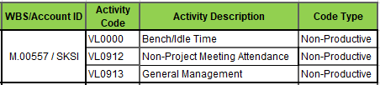
What is Labor Claim?
What is Utilization?
Labor Claim is declaring your time for work or non-work activities. Including project delivery, B&P(Bid & Proposal), as well as non-work time such as Learning time, Holiday & Vacation, Bench/Idle. At least 40 hours in total should be submitted per week.
Labor Claim Tool: Please use TIME@IBM to claim your time, refer to Page 21.
Why Labor Claiming Is Necessary : Please refer to Page 4.
Labor Claim Policy: Please refer to Page 5.
Utilization is the concept which helps us to understand/track how IBM practitioners’ time is being spent.
This is the way to track accurately whether a practitioner is working all the given available hours and the exact distribution of the available hours, i.e., if the given available hours are spent doing billable/chargeable project delivery, productive work or it also involves idle hours and non-productive activities.
Billable Ute: Commercial project owned by IBM Consulting (GB0020)
Chargeable Ute: T&M Project delivery effort but not paid by client (GN0035) or other LoB Contracts.
Non-Productive Ute: Time spent between assignments whether available for work or awaiting the start of next assignment, or time spent on internal administrative activities (VL0000/VL0912,etc)
Project Delivery
B&P
Learning
Holiday & Vacation
Bench/
Idle
WBS/Account ID | Activity Code | Activity Description | Code Type
C.XXXXX.001 | GB0020 | General Billable | Billable
 | GN0035 | Costed not Billable | Chargeable
Productive Ute: Bid & proposal, engagement work(GN0919)
WBS/Account ID | Activity Code | Activity Description | Code Type
B.XXXXX | GN0919 | New Business Development | Productive
Non-Productive Ute: All vacation within your standard entitlement, Public Holidays and any days that IBM designates as holidays (XL0A00/XL0B00, etc)
Productive Ute:
Classroom/Online training,etc(XL0H00/VL0947)
WBS/Account ID | Activity Code | Activity Description | Code Type
M.00556 / SK77 | XL0A00 | Vacation | Non-Productive
 | XL0B00 | Designated Holiday | Non-Productive
 | XL0D00 | Illness | Non-Productive
WBS/Account ID | Activity Code | Activity Description | Code Type
M.00562 / SK77 | XL0H00 | Non-IBM Learning | Productive
M.00563 / SKSI | VL0947 | IBM Learning | Productive

Slide 5

Why Labor Claiming Is Necessary?
5
4
3
CLAIM generates utilization history that will define commercial rates, as well as giving us historical data on which to base our future Client solutions.
Optimization
2
CLAIM generates reports that give us the ability to manage IBM Consulting productivity in our projects and among our people.
IBM Consulting Operations Management
1
CLAIM generates internal financial transactions that enable costs to be connected to the appropriate projects.
Project Finance Management
Utilization represents your productivity which is one of the key measurement on individual performance
IBM Consulting practitioners will record their own client services labor accurately and honestly on a weekly basis, in compliance with the IBM Business Conduct Guidelines.
CLAIM is the basis for invoices to our Clients.
IBM Consulting Revenue

Slide 6




Labor Claiming Policy
Full Labor Claiming
Fully, Truly and Timely against appropriate codes with right number of hours
4. AVOID PRIOR QUARTER ADJUSTMENT(PQA)
避免跨季度调整工时
To mitigate impact to IBM quarterly financial results, prior quarter labor claim adjustments should only be done in exceptional circumstances and be limited to valid scenarios.
5. AVOID LEAVE MISMATCH 避免休假记录的不一致
Practitioners claimed Time Away hours in ILC/CATS/TIME system must have corresponding approved leave request in Workday
KEY
4
5
3. USE AWAITING CODE PROPERLY
合理使用Awaiting Code
ONLY applicable to the case while Account code release is in process, contract was signed or B&P/MD&SI but Account code is unavailable due to admin process, Practitioners should move hours from awaiting code to the code actually worked within 15 working days
6. AVOID ABUSE OF CLAIM FOR OTHERS(CFO) 避免使用CFO申报工时
CFO access should be used for very exceptional scenarios only upon the request from Practitioner/PMO/PM/POP/PeM with strong justification
3
6
ALL IBM Consulting
Practitioners
2. AVOID MISSING CLAIM
避免遗漏工时申报
All hours should be claimed within the week worked, submit weekly hours by COB of Friday. Late submission/no submission will be considered as Missing Claim
2
MUST DO
Work what you claim, and claim what you work
1
DO NOT
Falsify or omit labor claiming
1. CLAIM BY ACTUAL 如实申报工时
Must record your labor hours accurately and honestly on a weekly basis.

Slide 7
Labor Claim Compliance Case Study
7

Slide 8

CASE STUDY 1A: CLAIM BY ACTUAL
Tom worked both for Project A and Project B in this month, sometimes he mixed up the project code and claimed hours randomly. Is this the right thing to do?
ANSWER: No! he should claim labor hours to project code actually worked. All practitioners must work what they claim and claim what they work. Do not falsify or omit labor claiming.
Learn more details, please refer to Full Labor Claim Guidance.
Guidance:
IBM Consulting practitioners, including Executives, must record their own labor accurately and honestly on a weekly basis. Reporting inaccurate or incomplete information or reporting information in a way that is intended to mislead or misinform those who receive it, is strictly prohibited and could lead to disciplinary actions.

Slide 9
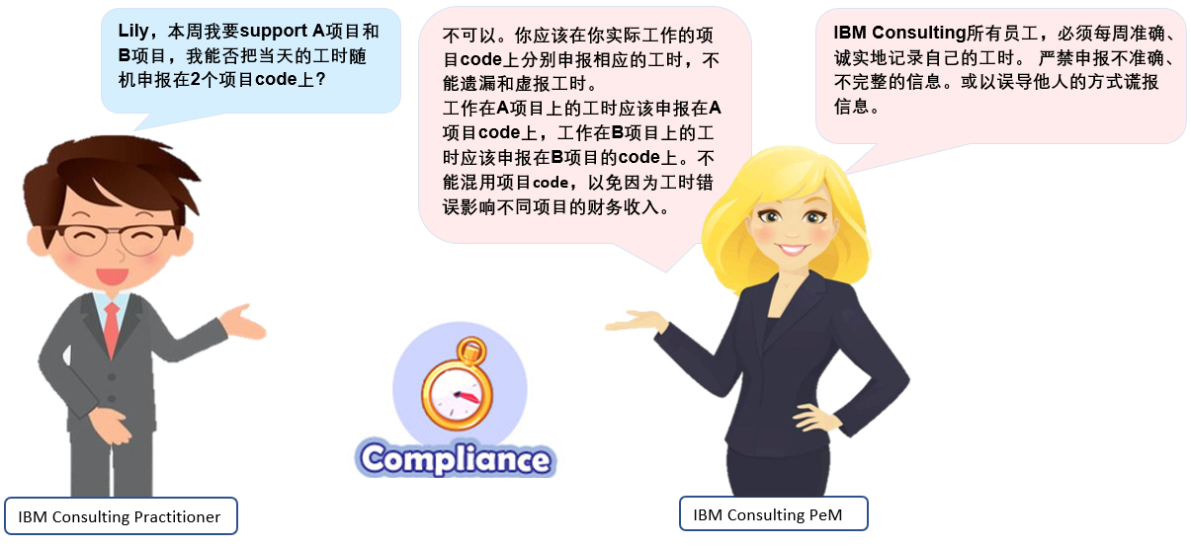

Slide 10
CASE STUDY 1B: CLAIM BY ACTUAL
Tom worked for project A, he actually worked 10 hours to do the project delivery on Monday, but PM asked Tom only claim 8 hours to the project code due PM want to balance project cost of current month, Is this the right thing to do?
ANSWER:
If it is a T&M(Time & Materials) project : Tom should claim his labor hours by using different activity codes for what he actually worked in the project. He should claim 8 hours under activity code GB0020(Bill to client) and 2 hours under activity code GN0035 (Not bill to client, cost booking to project).
If it is a FP(Fixed Price) project: Tom should claim labor hours to project code by actually worked. He should claim 10 hours under activity code GB0020 (Bill to client).
All practitioners must work what they claim and claim what they work. Do not falsify or omit labor claiming.
Learn more details, please refer to Full Labor Claim Guidance.
Guidance:
IBM Consulting practitioners, including Executives, must record their own labor accurately and honestly on a weekly basis. Reporting inaccurate or incomplete information or reporting information in a way that is intended to mislead or misinform those who receive it, is strictly prohibited and could lead to disciplinary actions.

Slide 11
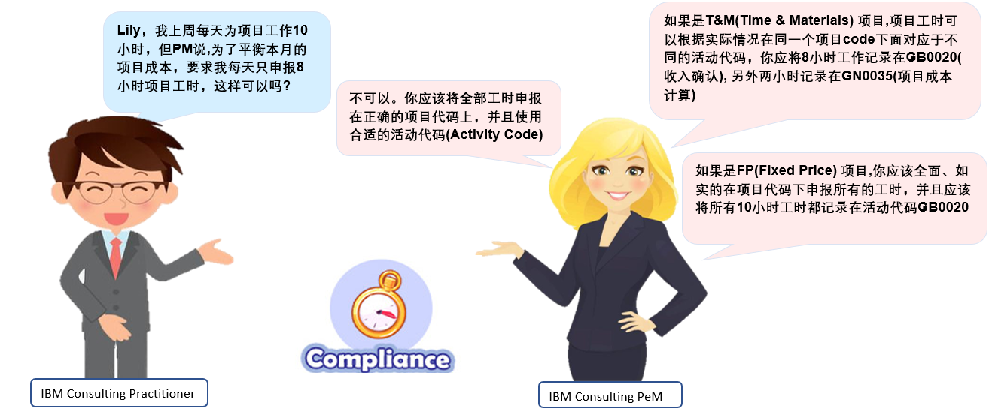

Slide 12

CASE STUDY 2: AVOID MISSING CLAIM
Kevin is a consultant and always busy in client office, this Friday he just flied back to Shanghai. It is late in the night when arrived and he supposed “ It is ok to submit labor hour in next Monday”. Is this the right thing to do?
ANSWER: No, he should claim labor hours by COB of Friday. Late submission / no submission will be considered as Missing Claim.
Tips:
1) Set Friday alarm clock.
2) Claim in TIME@IBM on Mobile.
Learn more details, please refer to Missing Claim Mgmt Guideline.
Escalation Rule:
Category | Action
1 time and aging >= 3 week; >=3 consecutive times; YTD = 5 times | Escalate to 1st line PeM, copy to 2nd line PeM & Practitioners +monthly report to Business Control for Disciplinary Action
YTD = 10 times | Escalate to Service line Leader & Sector Leader, copy to 1st line PeM & 2nd line PeM & Practitioners + monthly report to Business Control for Disciplinary Action
YTD >= 15 times | Escalate to Platform Leader & Tower Leader, copy to Service Line Leader & Sector Leader& 1st line PeM & 2nd line PeM & Practitioners + monthly report to Business Control for Disciplinary Action.

Slide 13
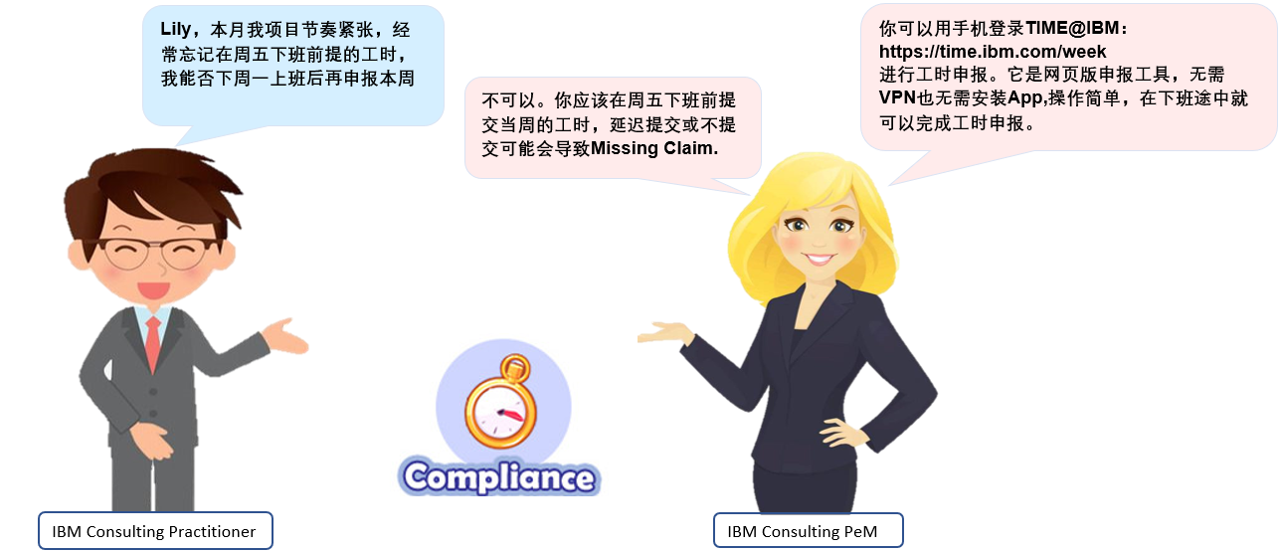

Slide 14

CASE STUDY 3: USE AWAITING CODE PROPERLY
Project A's contract already signed but project code still not available, Project Manager Jack plan to "borrow" a claim code from other project for team member's temporary claiming, is that OK?
ANSWER: No, project manager should apply awaiting Code instead of sharing account ID with another project. When project code is released, practitioner should convert labor hours from awaiting code to project code immediately.
Practitioners should claim labor hours on appropriate activity code, there are 4 types of activity codes under Awaiting code:
VL0820 - Awaiting for cost recovery
VL0830 - Awaiting for bid/proposal
VL0840 - Awaiting for internal/strategic investment
VL0850 - Awaiting for billable
Learn more details, please refer to Claim Awaiting Guideline.
Guidance:
Practitioners should move hours from awaiting code to the code actually worked within 15 working days.
Escalation Rule:
Category | Action
Awaiting Hours Aged> = 5 weeks and < 7 weeks | Escalate to Tower& Platform & Sector & Service Line Leader, copy to Practitioners & 1st line PeM
Awaiting Hours Aged>=7 weeks | Escalate to COO, copy to Tower& Platform & Sector & Service Line Leader +monthly report to Business Control for Disciplinary Action

Slide 15
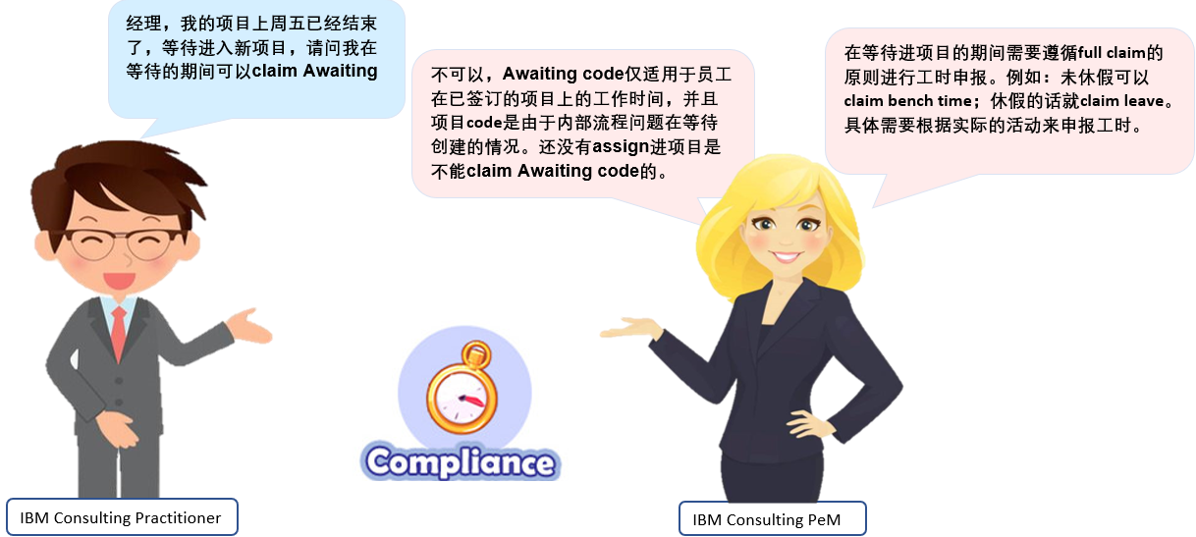

Slide 16

CASE STUDY 4: AVOID PRIOR QUARTER ADJUSTMENT
Thomas's Project Manager request him to remove the project claim hours which he actually worked in last quarter due to project cost concern. Can Thomas do that?
ANSWER: He should keep actual claim record and reject PM to remove project hours.
Any manipulation of labor clocking will be treated as business conduct violation. It's a potential violation & audit exposure against FLC policy.
Learn more details, please refer to PQA Guideline .
Guidance:
To mitigate impact to IBM quarterly financial results, prior quarter labor claim adjustments should only be done in exceptional circumstances and be limited to valid scenarios.
ILC system will be locked in any prior quarter adjustment on the next day of billing cutoff calendar quarter end. Practitioner should follow ILC Unlock Process.
Based on WW guidance, Labor adjustments are only possible for the current and the previous quarter. For previous quarter hours, practitioners shall NOT adjust prior quarters' hours unless there are strong business justifications under exceptional cases. Practitioners will be requested to provide email approval evidence from PM or DPE, when a PQA action with impact on billable/chargeable/B&P/MD&SI hours (both addition and reduction) is identified.

Slide 17
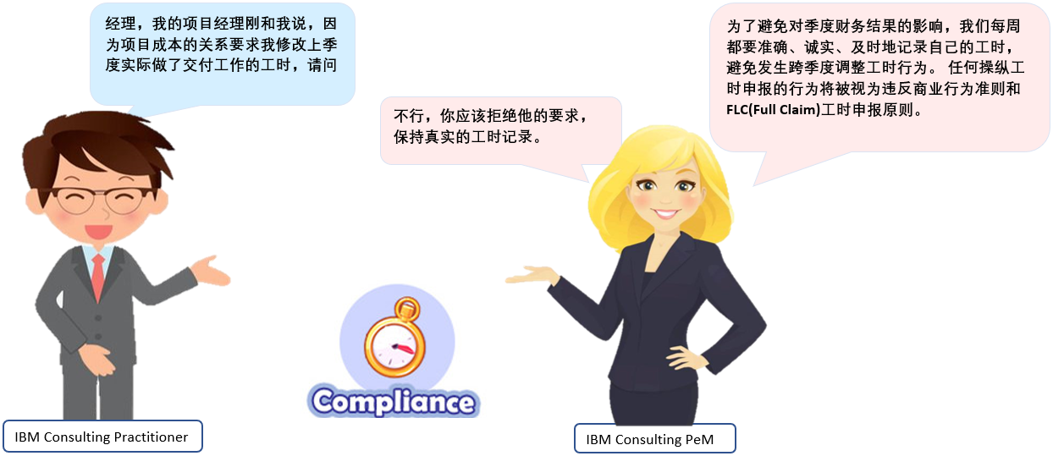

Slide 18

CASE STUDY 5: AVOID LEAVE MISMATCH
Robert planned to take annual leave this Friday, he already got PeM and PM email approval and he claimed 8 hours TIMEAWAY Code, but did not raise leave request in Workday? Is this the right thing to do?
ANSWER: No, he should raise leave request immediately and remind PeM to approve in WORKDAY. Otherwise, he will be considered as Labor vs HR Workday mismatch.
Learn more details, please refer to Leave Mismatch Management Guideline.
Guidance:
Time Away hours for vacation claimed in codes(SK77, WWTAWAY.) must have corresponding approved leave request in Workday.
Escalation Rule:
Leave mismatch reminder hierarchy | Action
1st week of current month: mismatch detailed from the Last quarter to last month | Potential mismatch reminder to Practitioners
2nd week of current month: mismatch detailed from the Last quarter to last month | Escalate to 1st line PeM, copy to 2nd line PeM& Practitioners
3rd week of current month: mismatch detailed from the Last quarter to last month | Escalate to Service Line Leader / Sector Leader,
 | copy 1st line PeM& 2nd line PeM & Practitioners
4th week of current month: mismatch detailed from the Last quarter to last month | Escalate to Platform Leader & Tower Leader,
 | copy to Service Line Leader/ Sector Leader & 1st line PeM& 2nd line PeM& Practitioners
if the leave mismatch still can not fix at the end of last month, then leave mismatch>=40 hrs will report to Business Control for Disciplinary Action

Slide 19


Slide 20

CASE STUDY 6: AVOID ABUSE OF CLAIM FOR OTHERS(CFO)
Tracy is authorized as CFO claimer, Project E will launch in next Monday, all team members are busy on product testing, project manager Charlie request Tracy to claim labor hours for his project members to save their time. Can Tracy agree to do this?
ANSWER: No, CFO access should be used in very exceptional scenarios, like practitioner can not access IBM internet.
Project members should claim labor hours themselves by Friday close of business.
Learn more details, please refer to Claim for Others Guideline.
Guidance:
Practitioner/PMO/PM/WFM/PeM can initiate CFO request for a practitioner over email with CFO authorization form and business justification to a CFO claimer. In case that the adjustment is related to a previous quarter period, CFO requester should follow PQA guideline.
All GCG IBM Consulting domestic Subk’s labor claim in CATS can only be processed by named CFO claimers from Subk Operation team.

Slide 21

CASE STUDY 7: AVOID EXPENSE MISMATCH
Edison is a senior consultant, he worked 5 hours for project A on a Saturday afternoon, and submitted reimbursement taxi fee for that day, but he didn’t claim that Saturday working hours, is that ok?
ANSWER: No, Edison should claim by actual for every working hours including weekend and submit reimbursement based on corresponding project hours recoded on dates.
Claimed all expense on worked project code.
Learn more details of Expense Reimbursement, please refer to Travel@IBM Community ->Travel Expense Reimbursement Guideline.
Guidance:
Labor and expenses should be claimed to the consistent period, right code, and same project.
For project funded expense , the applicable project you choose to charge should have corresponding project hours recorded. Expense charge code and claim codes should belong to same project.
You should record all your working hours truthfully, including overtime hours, to align with OT related expense.

Slide 22
WARM PROMPT
If you feel you are being instructed by anyone to record hours not in line with the work performed, then please alert your People Manager immediately who will take appropriate action.
There are also ways to raise any concerns you may have about any instruction you receive from anyone that you are not comfortable with, and you can visit the IBM Trust and Compliance Website to learn more.
To learn more details about the Labor Claiming Principle and Guidance, please visit Labor Compliance Guidance website. Should you have any query related Labor Claim Compliance, please feel free to contact GCG IBM Consulting Labor Compliance/China/IBM.

Slide 23
Professional Accountability
23

Slide 24
What's Professional Accountability ?
To enable this focus, Professional Scorecards and Automated Reminders will be deployed globally: MyScore - A web-based application to ensure professionals and their managers are aware of key metrics including Labor Claim status, CV currency, and Hours Plan accuracy.
Automated reminders in Slack for Labor Claim and outdated CVs - Slack reminders will come from ‘wfm_for_ibm_services’.
Please take a moment to watch Mark Foster discuss the importance of Professional Accountability from all IBM Services Professionals as a cornerstone of a Professional Services organization.
We are asking all IBM Services Professionals to focus on three key areas going forward:
Review and refresh your professional profiles (skills and CVs) at least every 6 months
As a Services business, our professionals create value for our clients through unique skills and experiences as well as thought leadership and insights. It is critically important that those skills are up-to-date and fully transparent in our management systems.
Claim your Labor on time every week
Consistent with the Labor Claiming policies, with the exception of specifically excluded roles, it is part of every Professional's responsibility to submit their time sheet on time using the appropriate labor reporting tools and deadlines for your Geography and Business Unit.
Submit an accurate Hours Plan forecast
Again, with the exception of specifically excluded roles, every IBMer should submit an Hours Plan forecast per their local unit guidance. This is a vital piece of information in forecasting our future economics and understanding the available capacity to staff new demand.
CV Wizard AP
My Hours Plan in MySA: https://w3.ibm.com/services/tools/mysa/app/#/login
Detail please go WFM W3 publisher: Professional Accountability & MyScore .
Actions Required
Where can I find more Information?

Slide 25
Backup
25

Slide 26
What is Utilization?
Utilization is the concept which helps us to understand/track how IBM practitioners’ time is being spent. This is the way to track accurately whether a practitioner is working all the given available hours and the exact distribution of the available hours, i.e. if the given available hours are spent doing billable/chargeable project delivery, productive work or it also involves idle hours and non-productive activities.
To enable the linkage between practitioners and revenue while encouraging the sharing of resources across LOBs, three tiers of utilization exist. Practitioners receive billable utilization credit for work on commercial contracts within his/her LOB and receive chargeable utilization credit for work performed for other LOBs.
IBM Utilization Categories
 | Billable | Chargeable | Productive
Definition | IBM Consulting Labor performed on COMMERCIAL contracts owned by IBM consulting Lob | Billable + ANY type of contract owned by ANOTHER Lob | Chargeable + IBM Consulting Bid & Proposal + IBM Consulting Internal
WW Reporting Terms | Billed Hrs | Utilized Hrs | Utilized Hrs + Strategic Investment Hrs + B&P Hrs
Elements | Commercial IBM Consulting contracts | IBM Consulting Billable work Any contract owned by another Lob IGA IRB (Investment Review Board) Pooled Labor (HTP) GN0035 Activity (costed, but not invoiced to customer) | Chargeable work IBM Consulting Bid & Proposal IBM Consulting Strategic Investment Learning & Education (VL0947 & XL0H00) Mentoring & Coaching (VL0942)
Why ? | IBM Consulting Revenue | Over/Under | Resource Productivity GD Over/Under
Utilization related & FAQ
https://w3.ibm.com/w3publisher/consulting-labor-compliance-guideline/labor-compliance-guideline/utilization-metrics-introduction

Slide 27
Activity Codes List
We have 2 claim system-CATS & ILC：WBS code for CATS system, Account ID for ILC system
Scenario | WBS/Account ID * | Activity Code | Activity Description | Code Type | Comments
For Billable Accounts | C.XXXXX.XX1 | GB0010 | Marketing Billable | Billable | Contract marketing hours
 |  | GB0020 | General Billable | Billable | Contract billable hours (not including travel)
 |  | GB0100 | Travel Billable | Billable | Contract travel hours
 |  | GN0035 | Costed not Billable | Chargeable | Client contract but not billable. This should only be used on customer projects with the agreement of the Project Manager.
 |  | GN0900 | Travel not Billable | Chargeable | Client contract travel not billable. This should only be used on customer projects with the agreement of the Project Manager.
 |  | GN0218 | Early Roll-Off | Non-Productive | Limited to GIC or BPOD resources when there is an early termination of a commercial project requiring an early roll-off. This code is authorized where the required advanced notice is not provided by the customer. A charge back period will be applied, but no more than a pre-dertimed time specified. Code effective 3Q20 start. (IBM Consulting Domestic Resource would require prior written approval from local leadership before usage. )
For Learning Hours | M.00562 / SK77 | XL0H00 | Non-IBM Learning | Productive | Time spent on external non-IBM training courses and non-IBM related classes/training, e.g., Mgmt, approved MBA program.
 | M.00563 / SKSI | VL0947 | IBM Learning | Productive | Time spent on internal IBM training courses and education including Onboarding Training, Online IBM Training, IBM Classroom Training, Self-Study Training & E-Mobilization.
For Awaiting Hours | M.00561/ SKSI | VL0820 | Wait WBS-Cst Rcv | Non-Productive | Only to be used for Cost Recovery work where the contract is signed but the account id is not available due to the Admin process.
 |  | VL0830 | Wait WBS-B&P | Non-Productive | Only to be used for Client Bid & Proposal work where the Opportunity account id is not available due to the Admin process.
 |  | VL0840 | Wait WBS-Mgt Dcd | Non-Productive | Only to be used for Strategic Investment work where the account id is not available due to the Admin process
 |  | VL0850 | Wait WBS-Billable | Non-Productive | Only to be used for Client Billable work where the account id is not available due to the Admin process
General Opportunity | B.XXXXX | GN0919 | New Business Development | Productive | Bid and Proposal activities.

Slide 28
Activity Codes List
We have 2 claim system-CATS & ILC：WBS code for CATS system, Account ID for ILC system
Scenario | WBS/Account ID * | Activity Code | Activity Description | Code Type | Comments
For Timeaway Hours | M.00556 / SK77 | XL0A00 | Vacation | Non-Productive | All vacation within your standard entitlement
 |  | XL0B00 | Designated Holiday | Non-Productive | Public Holidays and any days that IBM designates as holidays
 |  | XL0C00 | Optional Holiday | Non-Productive | Agreed additional holiday
 |  | XL0D00 | Illness | Non-Productive | Includes all planned and unplanned illness, accident, hospitalisation and medical appointments - doctors, dentists, opticians etc. Not for long-term sick (see XL0I00)
 |  | XL0I00 | Paid time not worked | Non-Productive | Any additional leave authorized by management including support of external activities. Examples are - compassionate leave, long-term sickness/accident, jury service, military leave, school governor, prison visiting, Justice of the Peace, other charity work.
 |  | XL0J00 | Unpaid time not worked | Non-Productive | Used by part-timers to record the difference between their contracted hours and the total weekly hours expected by ILC/Claim
 |  | XL0K00 | Pre/Post IBM Employ | Non-Productive | Used by AS for time before/after an employee begins employment with IBM in the middle of a week. Used to fill in the days they were not employed.
 |  | XL0Y00 | Parenting Time Off | Non-Productive | Absences from work resulting from taking advantage of available paid parental leave policies
 |  | XL0A00 | Subk vacation | Non-Productive | Subk vacation
For Unbilled Account | M.00557 / SKSI | VL0000 | Bench/Idle Time | Non-Productive | Time spent on internal administrative activities, activities not fitting other allowable categories, or time spent between assignments whether available for work or awaiting the start of next assignment. In 2014, the following activities are now included: Non-Contract Travel, Empl. IBM HR & People Management activity, Other Marketing, IBM Internal Software Maintenance, IBM Personal Hardware Maintenance, Proj Rev Assistance, Internal staff work, Audit and QA Activity, Project Resource Xfer and Marketing Not Billable, People Manager activity, etc.
 |  | VL0101 | Professional Development and Giveback | Non-Productive | Includes activities such as: Non-Management Leadership, IBM Group / Board time, PM Certification, Recruiting & Create Intel Capital.
 |  | VL0942 | Mentoring Program | Productive | Applies to individuals providing or receiving Coaching/Mentoring. Mentoring supports the development of the individual's capability and potential, and is concerned with implications beyond task and activities with emphasis on feedback and reflection by the mentee; Typically a longer-term relationship beyond the Line Manager-Employee regular interactions. Coaching is concerned with tasks, activities, and setting goals - developing employees in specific competencies/skills; Focuses on skills and measuring performance periodically; Primarily done by a Line Manager; Typically addresses a short-term need.
 |  | VL0911 | Administrative Time | Non-Productive | Non-Project Administration. This activity code should have minimal use by perform or billable practitioners. It is to be used for time spent on business unit specific administration or support. Note: Time spent on project related administration must be recorded against the project work items.
 |  | VL0912 | Non-Project Meeting Attendance | Non-Productive | Department or Business Unit meetings. This activity code should have minimal use by perform or billable practitioners. It is to be used for time spent on internal meetings not related to a project. For example, meetings relating to the performance or activities of the business unit. Note: Time spent on project related administration must be recorded against the project work items.
 |  | VL0913 | General Management | Non-Productive | Business Management. This activity code should have minimal use by perform or billable practitioners. It is to be used for time spent on business unit management activities.

Slide 29

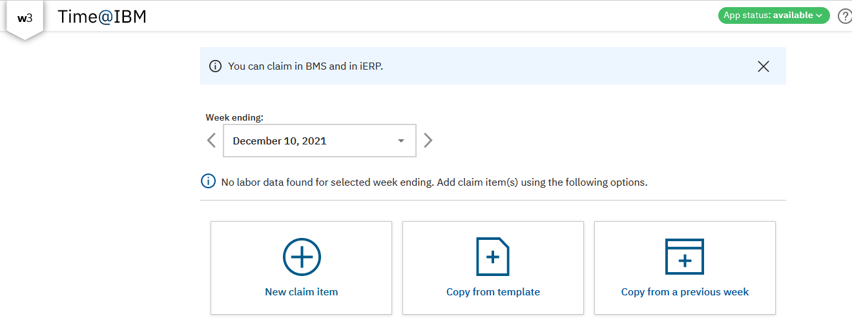
Labor Claim Tool—Time@IBM
Labor Claiming with WBS Elements & Account ID at the same time
Friendly interface, No need VPN, No need install App, just click link to action：https://time.ibm.com/week
TIME@IBM user guide video please check in: https://ibm.ent.box.com/s/nd6qtpl5edrt5sh8cbkg0wz5z2frrmv9
TIME@IBM FAQ: https://time.ibm.com/faq
Time@IBM support: https://time.ibm.com/support
Time@IBM education: https://learn.ibm.com/mod/book/view.php?id=132984
Time@IBM is a new web based, mobile enabled user interface for labor claiming and it will be connected with both iERP and BMS backbends.
TIME

Slide 30
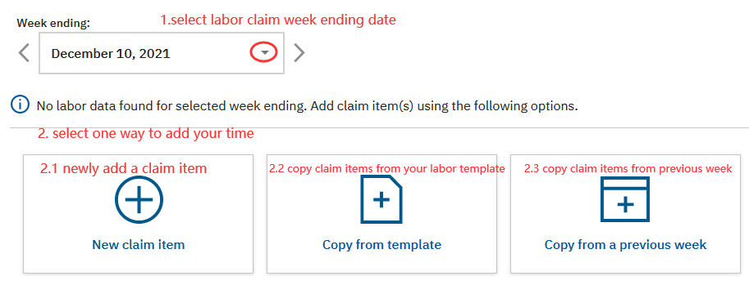
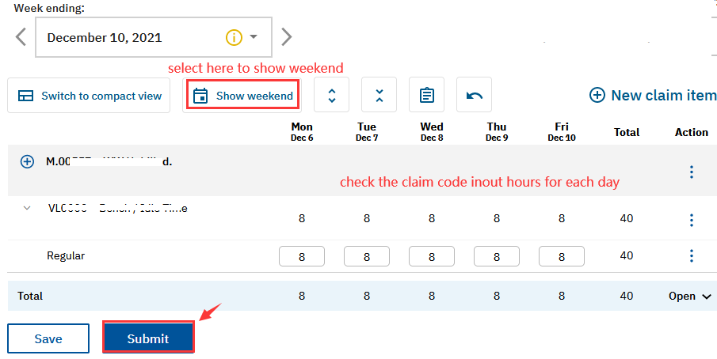
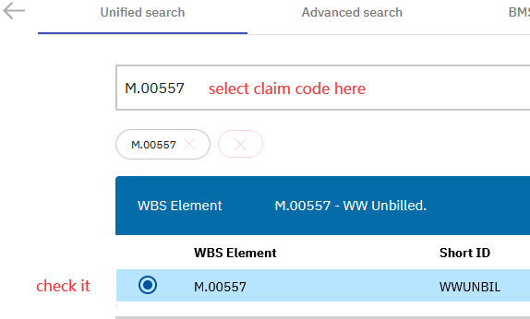
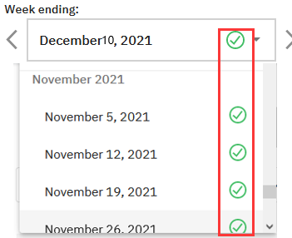
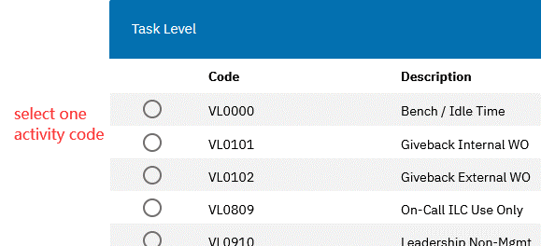
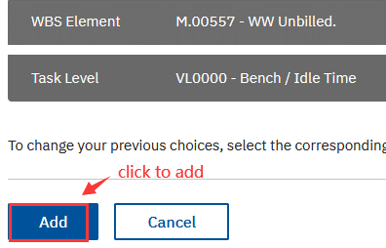
How to Claim hours in Time@IBM- web version
Enter TIME@IBM with your W3 ID： https://time.ibm.com/week
1.Select labor claim week → Click “New claim item”
3. Claim your project/non-project code and hours → Submit
2. Select claim code and task level → Add
4. Green tick means your claiming was success
IBM Consulting / © 2021 IBM Corporation

Slide 31
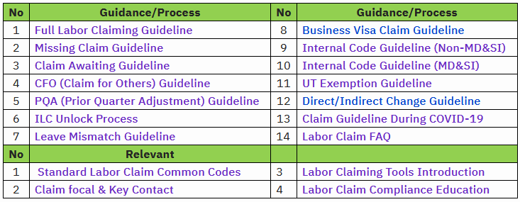
Labor Compliance
GCG IBM Consulting Labor Compliance Process
IBM Consulting Standard Labor Claiming code
Please refer to GCG IBM Consulting WFM W3 publisher--- Standard Labor Claim common codes list
Labor Claim Account ID/WBS ID vs Activity Codes

Slide 32

IBM sign-off

